Slide 1
Warm Up
A Chinese citizen has a factory in the United States that makes a profit. Who’s GDP would they count towards? GNP?
What is REAL GDP?
What is the output expenditure model? What does it calculate?
What are some examples of goods or services not counted in GDP?
Why is the census important to economics?
What are the three factors that affect population growth?
CEQ: Of the 35 developed nations in the world, where does the United States rank in childhood poverty rate?
Notes:
34th…Only Romania is worse

Slide 2
Chapter 14

Slide 3
Chapter14
Business Cycles – Largely systematic ups and downs of real GDP
Business Fluctuations – The rise and fall of real GDP over time in a nonsystematic manner
Recession – A period of time which real GDP declines for two quarters in a row (6 months)
Peak – Where real GDP stops going up
Trough – Point where real GDP stops going down

Slide 4
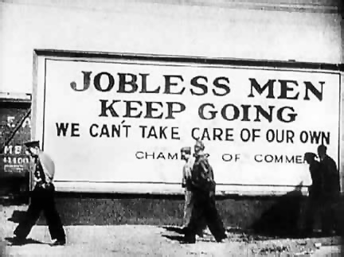
Chapter14
Expansion – A period of recovery from a recession
Trend Line – A steady growth path
Depression – A state of the economy with large numbers of people out of work, acute shortages, and excess capacity in manufacturing plants

Slide 5
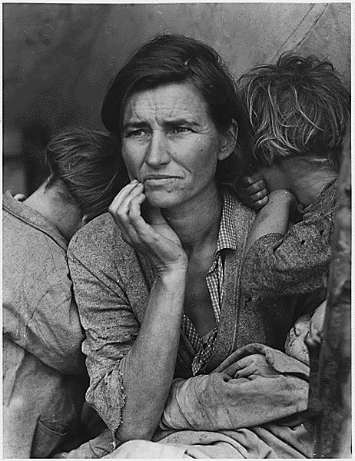
Chapter14
The Great Depression
“Black Tuesday” – Oct. 29th 1929
GDP falls from $103 billion to $55 billion
Unemployment grows by 800%
Banks failed across the nation
Banks were shut down by the government

Slide 6
Chapter14
Causes of the Great Depression
The gap between rich and poor was gigantic
Many were deeply in debt to credit
United States was heavily in debt due to loans to other nations
High tariffs on imports kept foreign nations from selling goods in the U.S.
No Bank regulation
A “Run” on the banks

Slide 7
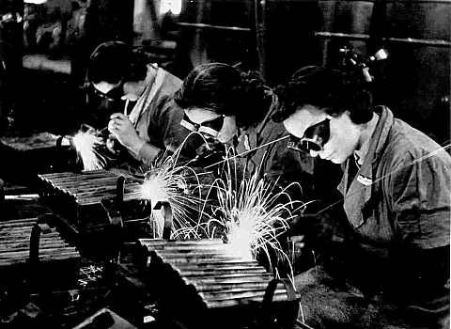
Chapter14
Business cycles of WWII officially got us out of the depression

Slide 8
Chapter14
Causes of the Business Cycle
Capital Expenditures – Companies expanding and contracting
Inventory Adjustments – Expanding or contracting inventories
Innovation and Imitation – Innovation gives companies and edge – copying those companies is expensive
Monetary Factors – Federal Reserve controls the money supply
External Shocks – Increase in oil prices or international conflict

Slide 9
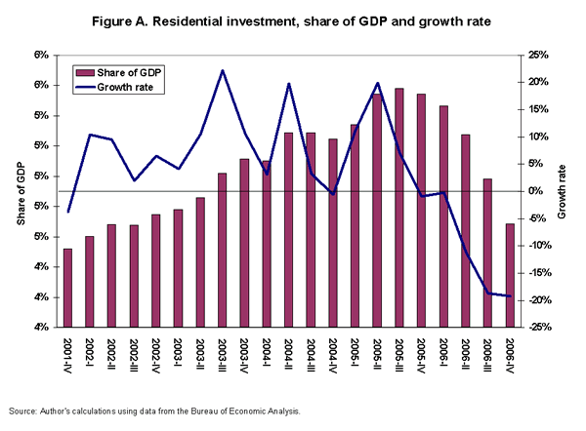
Chapter14
Predicting Business Cycles
Econometric Model – GDP = C + I + G + (X-M)
Index of Leading Indicators – A monthly statistical series that usually turns down before real GDP turns down

Slide 10
Chapter14
Unemployed – People available for work who made a specific effort to find a job up to one year
Unemployment Rate – The number of unemployed individuals divided by the total number of persons in the work force

Slide 11
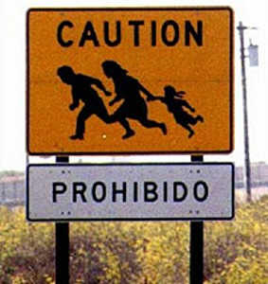
Chapter14
Limitations on the unemployment rate
Does not count…
People who have stopped searching for work
People unemployed for more than one year
Undocumented workers
People are considered employed if they have a part time job
People over 65 still looking for work

Slide 12
Chapter14
Kinds of Unemployment
Frictional Unemployment – Unemployment caused by workers who are between jobs
Structural Unemployment – a fundamental change in the operations of the economy which reduces the demand for workers
Cyclical Unemployment – Unemployment directly tied to the shift in the business cycle

Slide 13
Chapter14
Seasonal Unemployment – Unemployment caused by weather or changes in seasons
Technological Unemployment – Unemployment caused when workers with less skills, talent, or education are replaced by machines or other forms of technology

Slide 14
All Content Created by DJ Cook

